Slide 1


Slide 2
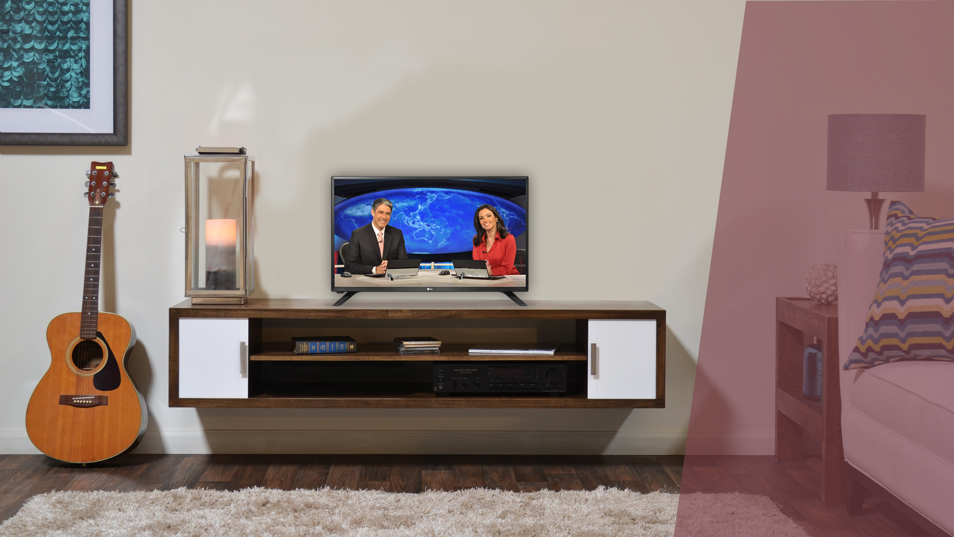

LED TV LJ50
32LJ500B
Imagem
TV Digital
Hd
AMPLO ÂNGULO DE VISÃO
Frequência 60
som
sistema de áudio 2.0 ch
Som envolvente 10W RMS
EXTRAS
SCREEN CAPTURE
MENU COM NOVO DESIGN
TIME MACHINE READy

Slide 3
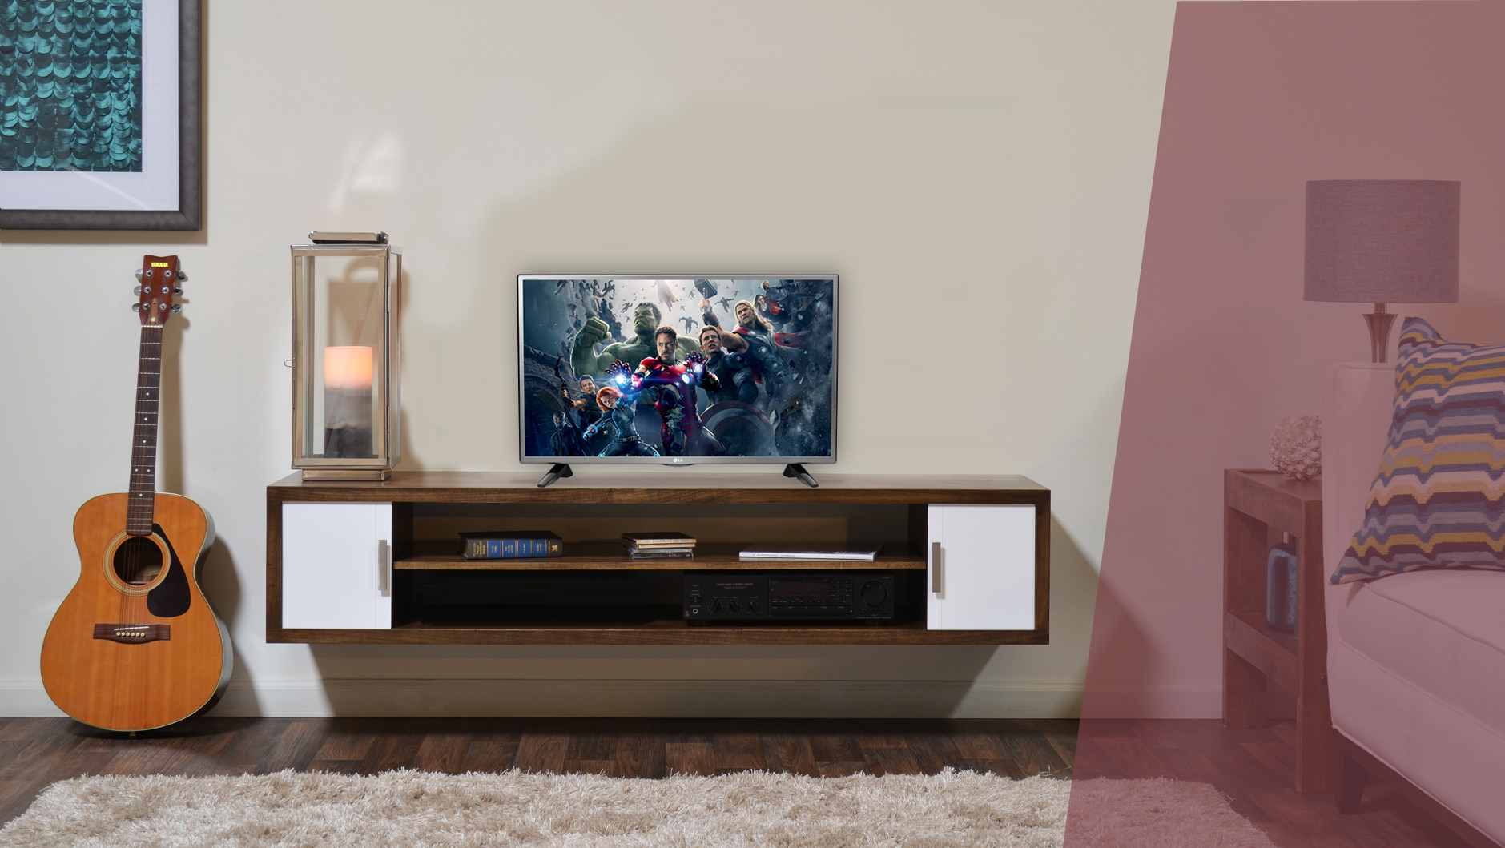
LED TV LJ52
32LJ520B
Imagem
TV Digital
Hd
AMPLO ÂNGULO DE VISÃO
Frequência 120
^{GAME TV}
^{3 JOGOS EMBARCADOS}
som
VIRTUAL SURROUND
CLEAR VOICE
EXTRAS
SCREEN CAPTURE
MENU COM NOVO DESIGN
TIME MACHINE READy

Slide 4
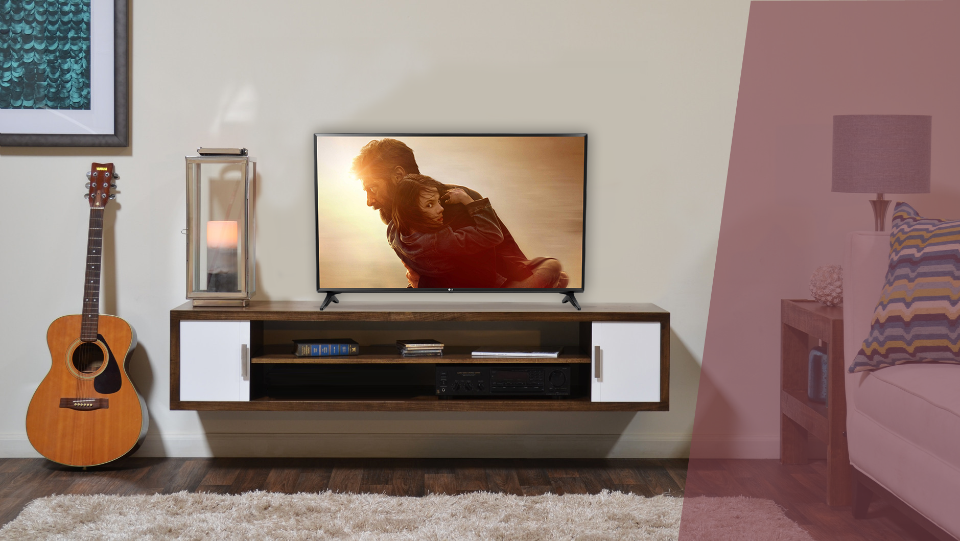

SMART TV LJ55
43 / 49LJ5500
Imagem
AMPLO ÂNGULO DE VISÃO – Painel IPS
TV DIGITAL
FULL HD
frequência 120
SMART TV
webOS 3.5
Live Zoom
Quick Access
Magic Mobile Connection
Time Machine READy
som
Virtual Surround Plus
Music Player
EXTRAS
2 HDMI
1 USB

Slide 5
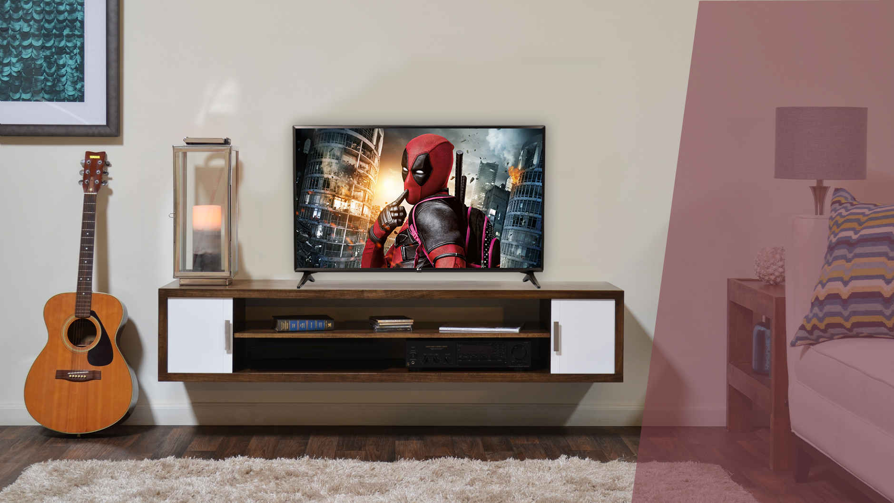
SMART TV LJ55
43 / 49 / 55LJ5550
Imagem
AMPLO ÂNGULO DE VISÃO – Painel IPS
TV DIGITAL
FULL HD
frequência 120
SMART TV
WEBOS 3.5
Live Zoom
Quick Access
Magic Mobile Connection
Time Machine READy
som
Virtual Surround Plus
Music Player
EXTRAS
2 HDMI
1 USB

Slide 6
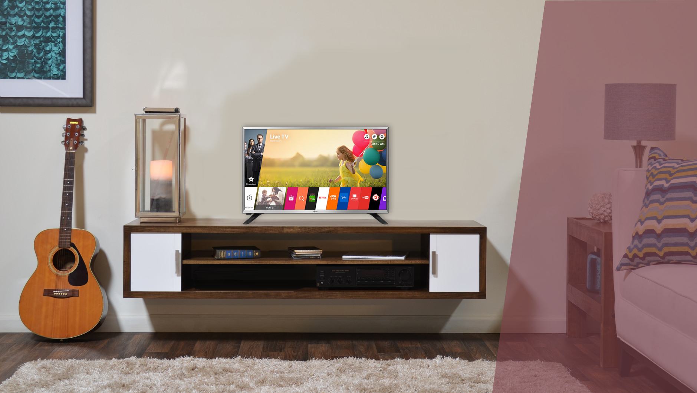
SMART TV LJ55
32LJ550B
Imagem
AMPLO ÂNGULO DE VISÃO
TV DIGITAL
HD
frequência 60
SMART TV
WEBOS 3.5
Live Zoom
Quick Access
Magic Mobile Connection
Time Machine READy
som
Virtual Surround Plus
Music Player
EXTRAS
2 HDMI
1 USB

Slide 7
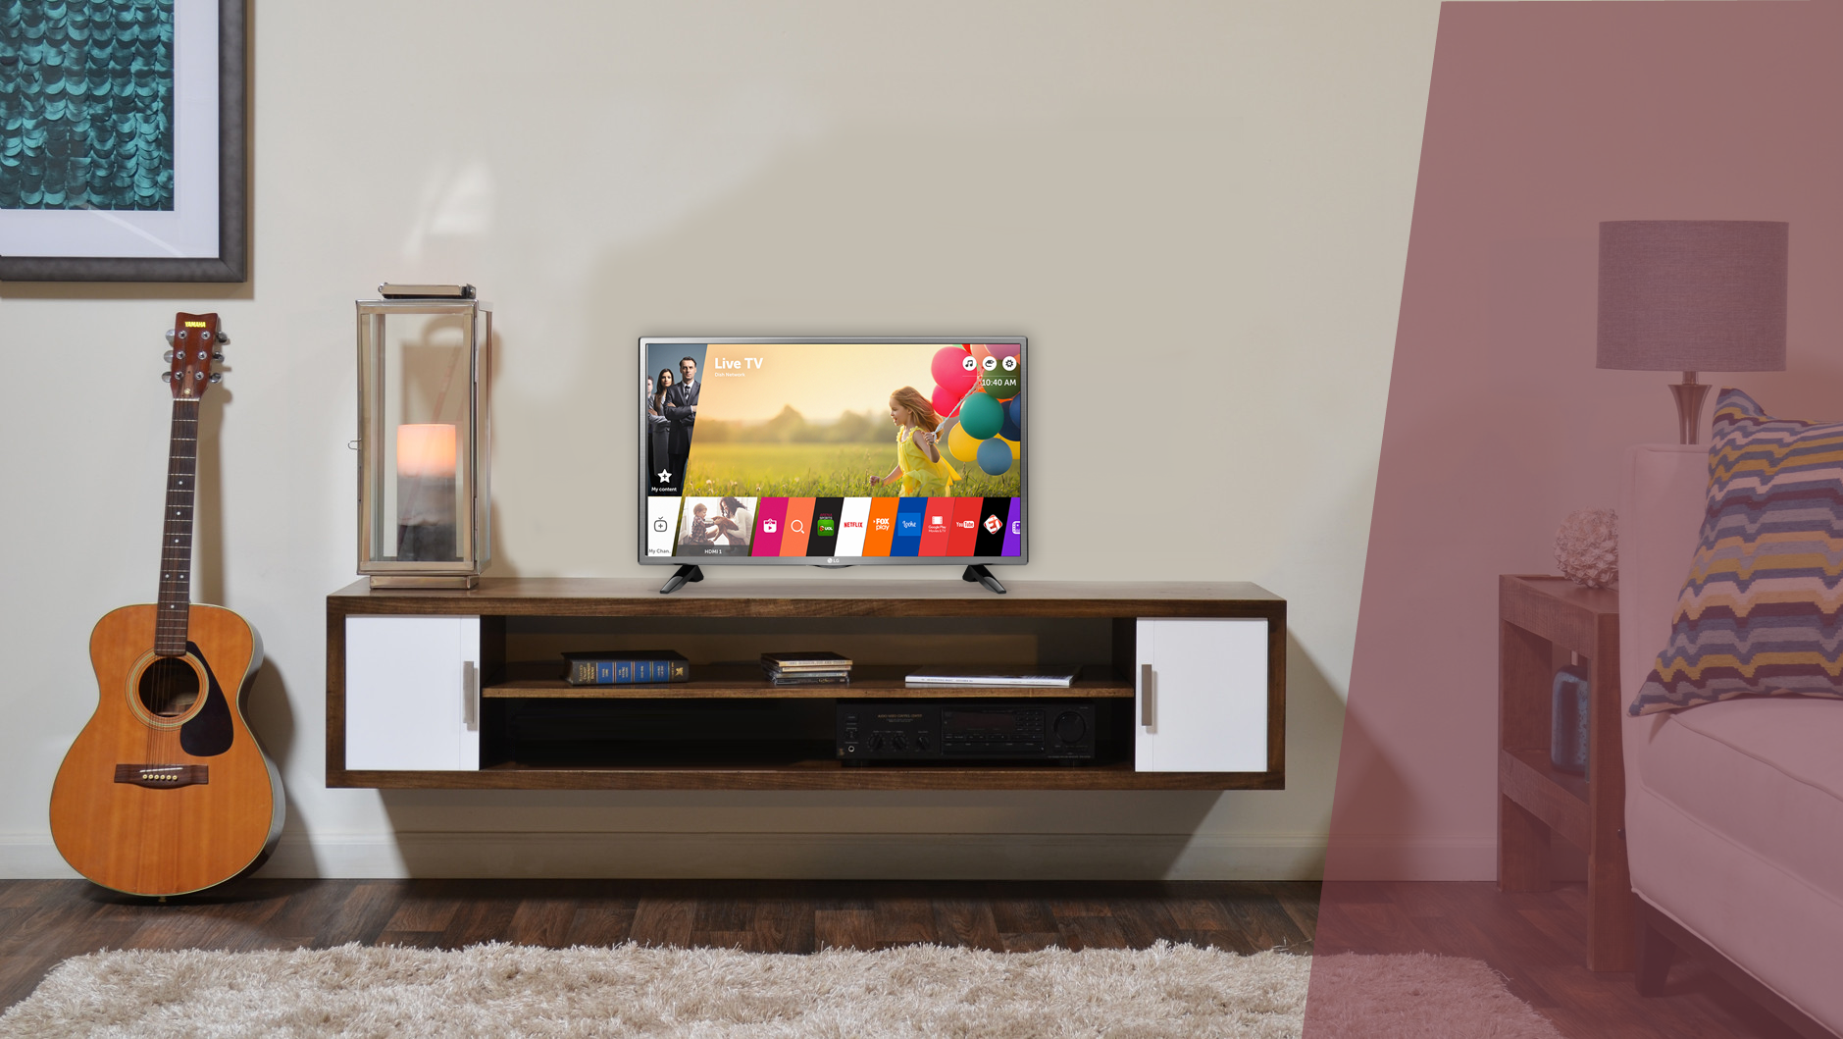
SMART TV LJ60
32LJ600B
Imagem
AMPLO ÂNGULO DE VISÃO
TV DIGITAL
HD
frequência 120
SMART TV
WEBOS 3.5
Live Zoom
Quick Access
Magic Mobile Connection
Time Machine READy
som
Virtual Surround Plus
Music Player
EXTRAS
2 HDMI
1 USB

Slide 8
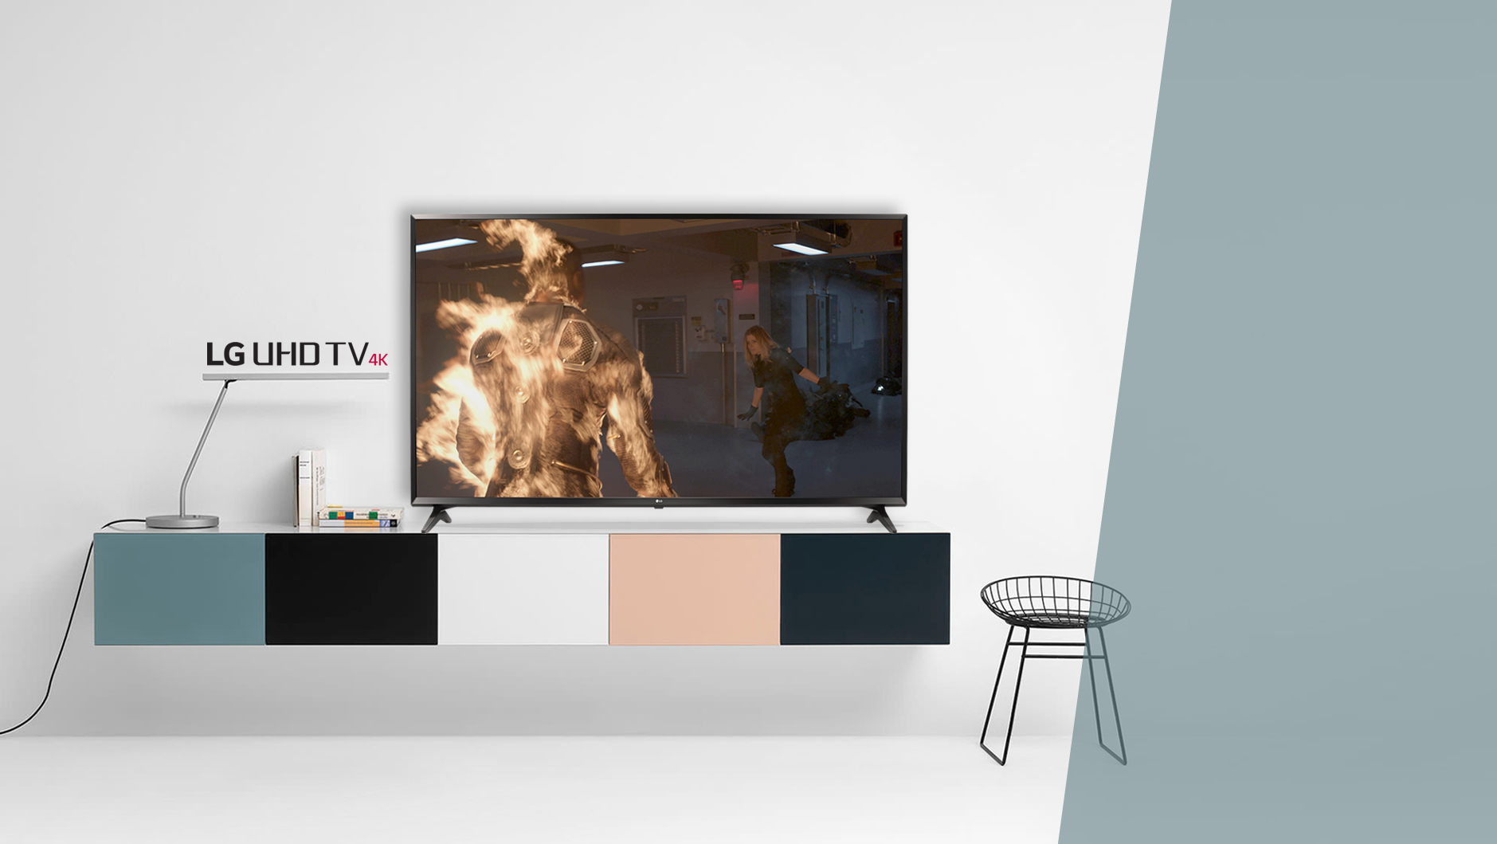
UJ63
^{Imagem}
^{Ultra HD 4K}
^{4K Upscaler}
^{HDR 10 / HDR Effect}
^{Wide Color GamuT DCI 80%}
AMPLO ÂNGULO DE VISÃO – Painel IPS
^{Local Dimming}
^{Ultra Luminância 55” / 60”}
^{frequência 120}
43 / 49 / 55 / 60UJ6300
^{SMART TV}
^{WEBOS 3.5}
^{Live Zoom}
^{Quick Access}
^{Magic Mobile Connection}
^{Time Machine READY}
^{Music Player}
^{som}
^{Ultra Surround}
^{Modo Smart Sound}
^{Sound Sync wireless}
^{EXTRAS}
^{3 HDMI 2.0}
^{2 USB}
^{1 saída digital óptica}
^{Quad Core}

Slide 9
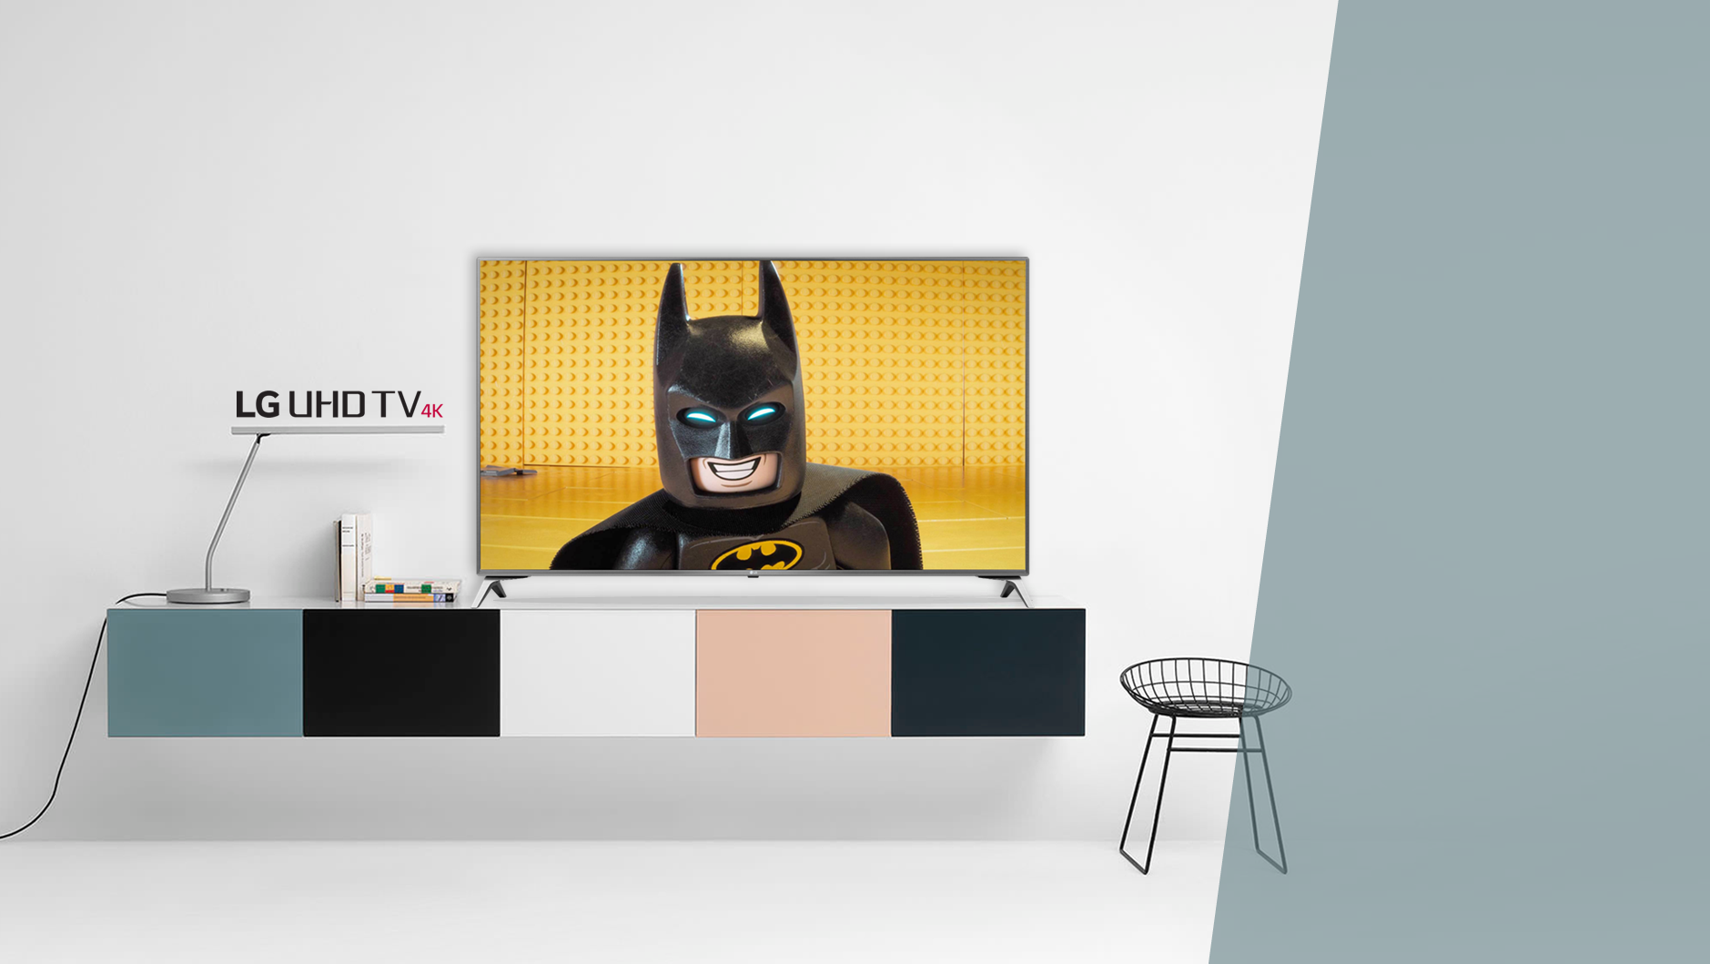
UJ65
^{Imagem}
^{Ultra HD 4K}
^{4K Upscaler}
^{HDR 10 / HDR Effect}
^{Wide Color GamuT DCI 84%}
AMPLO ÂNGULO DE VISÃO – Painel IPS
^{Local Dimming}
^{frequência 120}
43 / 49UJ6525
^{SMART TV}
^{WEBOS 3.5}
^{Live Zoom}
^{Quick Access}
^{Magic Mobile Connection}
^{Time Machine READY}
^{Music Player}
^{som}
^{Ultra Surround}
^{Modo Smart Sound}
^{Sound Sync wireless}
^{EXTRAS}
^{4 HDMI 2.0}
^{2 USB}
^{1 saída digital óptica}
^{Quad Core}

Slide 10
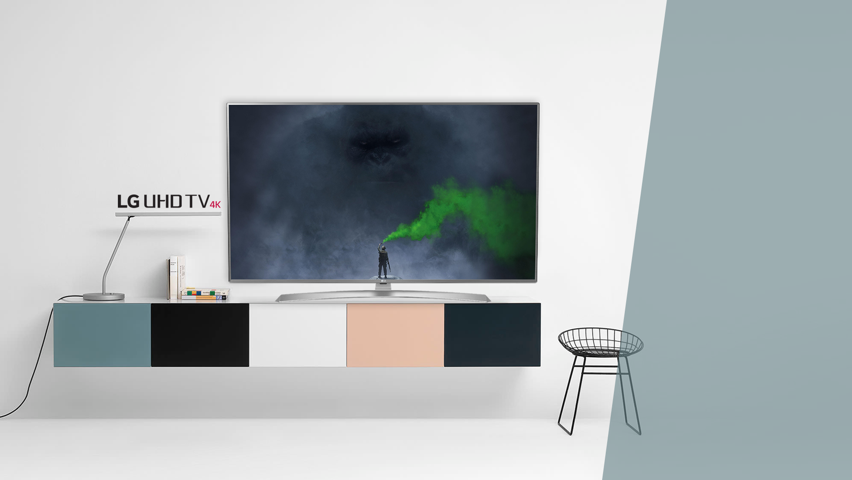
UJ65
55 / 60 / 65UJ6545
^{Imagem}
^{Ultra HD 4K}
^{4K Upscaler}
^{HDR 10 / HDR Effect}
^{Wide Color GamuT DCI 84%}
AMPLO ÂNGULO DE VISÃO – Painel IPS
^{Local Dimming}
^{Ultra Luminância}
^{frequência 120}
^{SMART TV}
^{WEBOS 3.5}
^{Live Zoom}
^{Quick Access}
^{Magic Mobile Connection}
^{Time Machine READY}
^{Music Player}
^{som}
^{Ultra Surround}
^{Modo Smart Sound}
^{Sound Sync wireless}
^{EXTRAS}
^{4 HDMI 2.0}
^{2 USB}
^{1 saída digital óptica}
^{Quad Core}

Slide 11
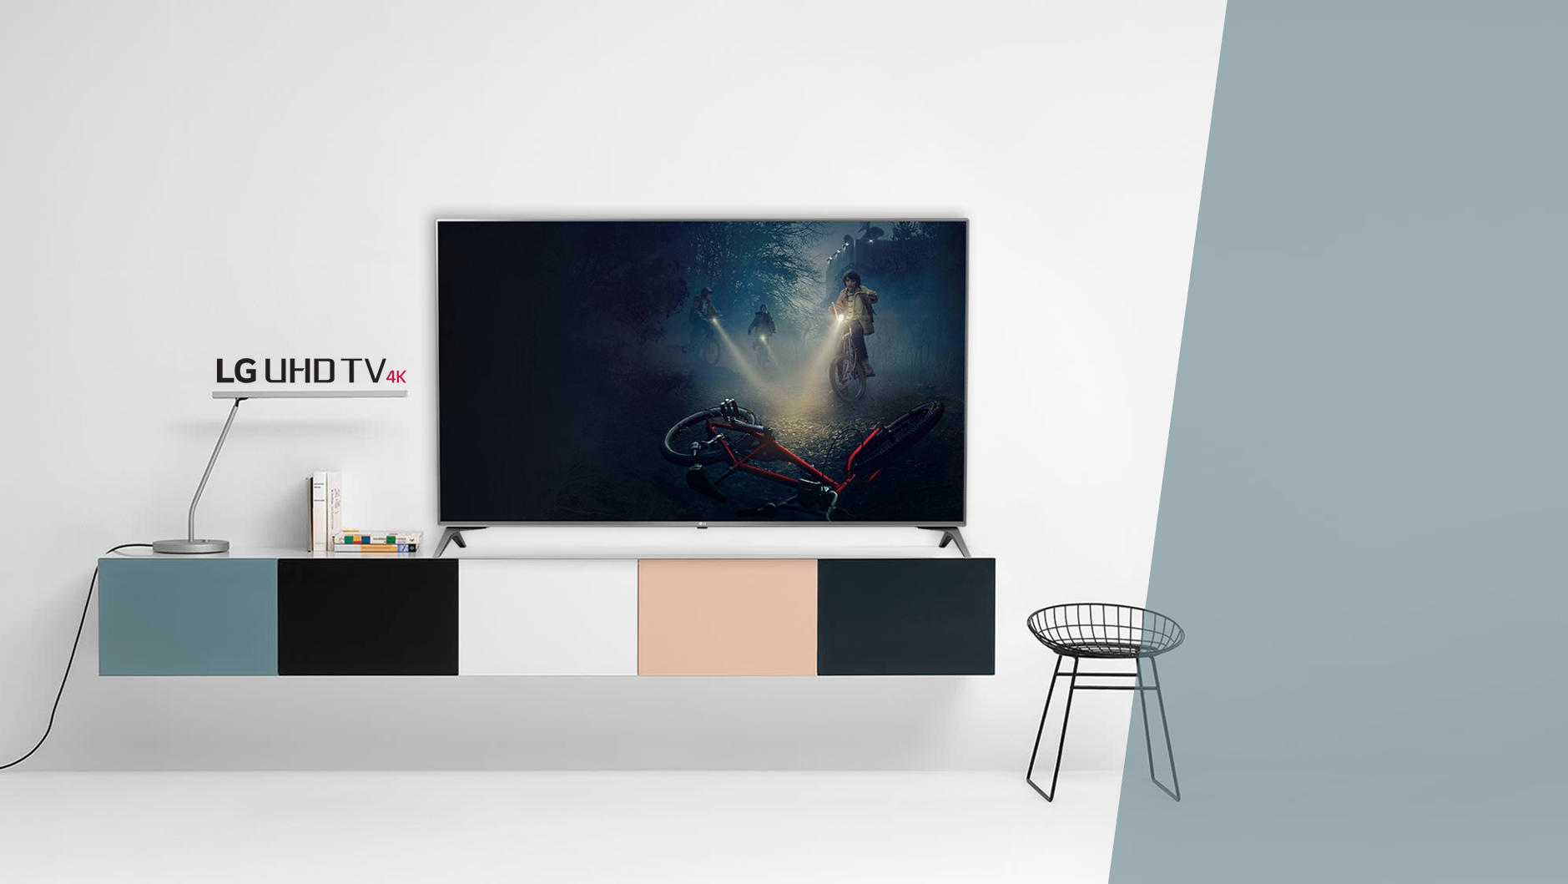
UJ65
43 / 49UJ6565
^{Imagem}
^{Ultra HD 4K}
^{4K Upscaler}
^{HDR 10 / HDR Effect}
^{Wide Color GamuT DCI 84%}
AMPLO ÂNGULO DE VISÃO – Painel IPS
^{Local Dimming}
^{frequência 120}
^{SMART TV}
^{WEBOS 3.5}
^{Live Zoom}
^{Quick Access}
^{Magic Mobile Connection}
^{Time Machine READY}
^{Music Player}
^{som}
^{Ultra Surround}
^{Modo Smart Sound}
^{Sound Sync wireless}
^{EXTRAS}
^{4 HDMI 2.0}
^{2 USB}
^{1 saída digital óptica}
^{Quad Core}

Slide 12
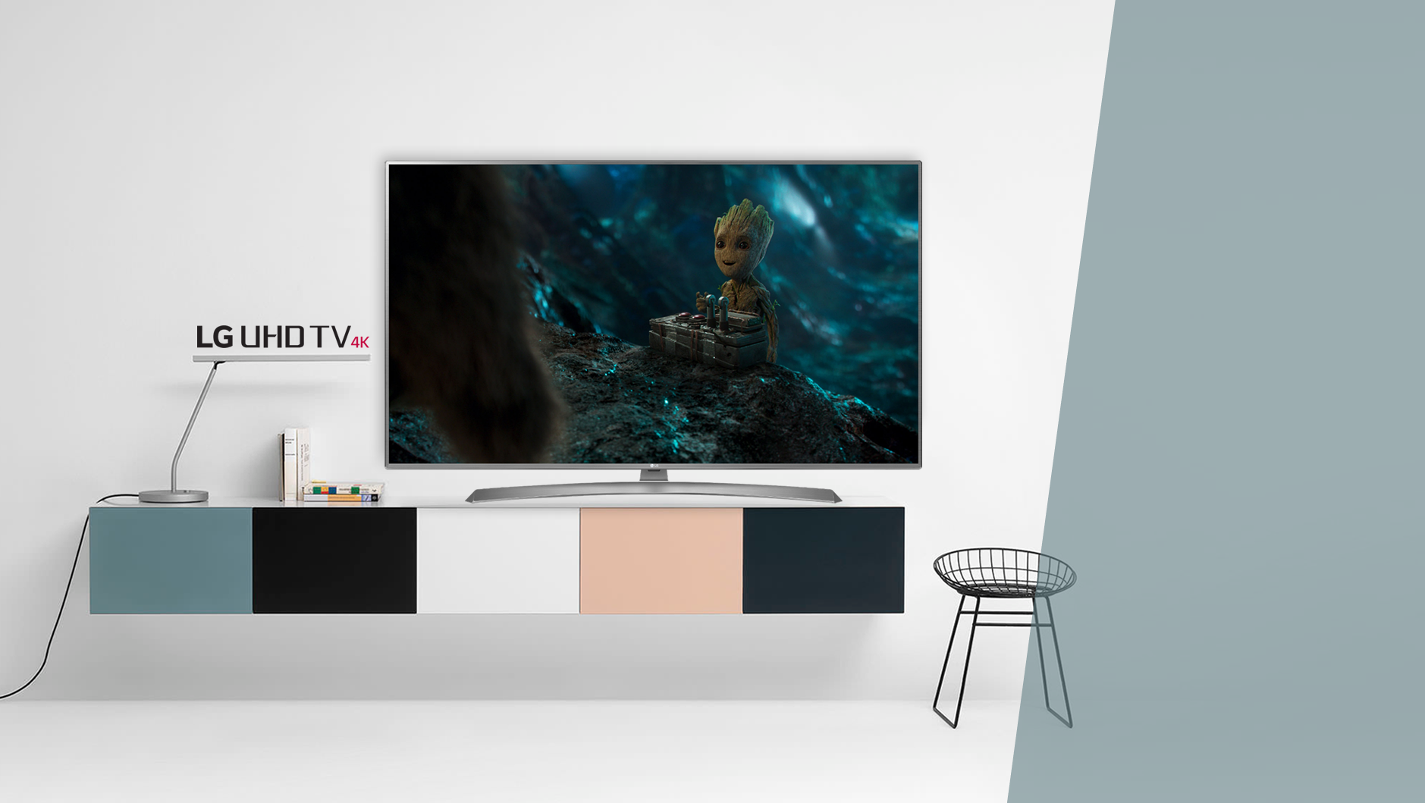
UJ65
55 / 60 / 65 / 75UJ6585
^{Imagem}
^{Ultra HD 4K}
^{4K Upscaler}
^{HDR 10 / HDR Effect}
^{Wide Color GamuT DCI 84%}
AMPLO ÂNGULO DE VISÃO – Painel IPS
^{Local Dimming}
^{Ultra Luminância}
^{frequência 120}
^{SMART TV}
^{WEBOS 3.5}
^{Live Zoom}
^{Quick Access}
^{Magic Mobile Connection}
^{Time Machine READY}
^{Music Player}
^{som}
^{Ultra Surround}
^{Modo Smart Sound}
^{Sound Sync wireless}
^{EXTRAS}
^{4 HDMI 2.0}
^{2 USB}
^{1 saída digital óptica}
^{Quad Core}

Slide 13
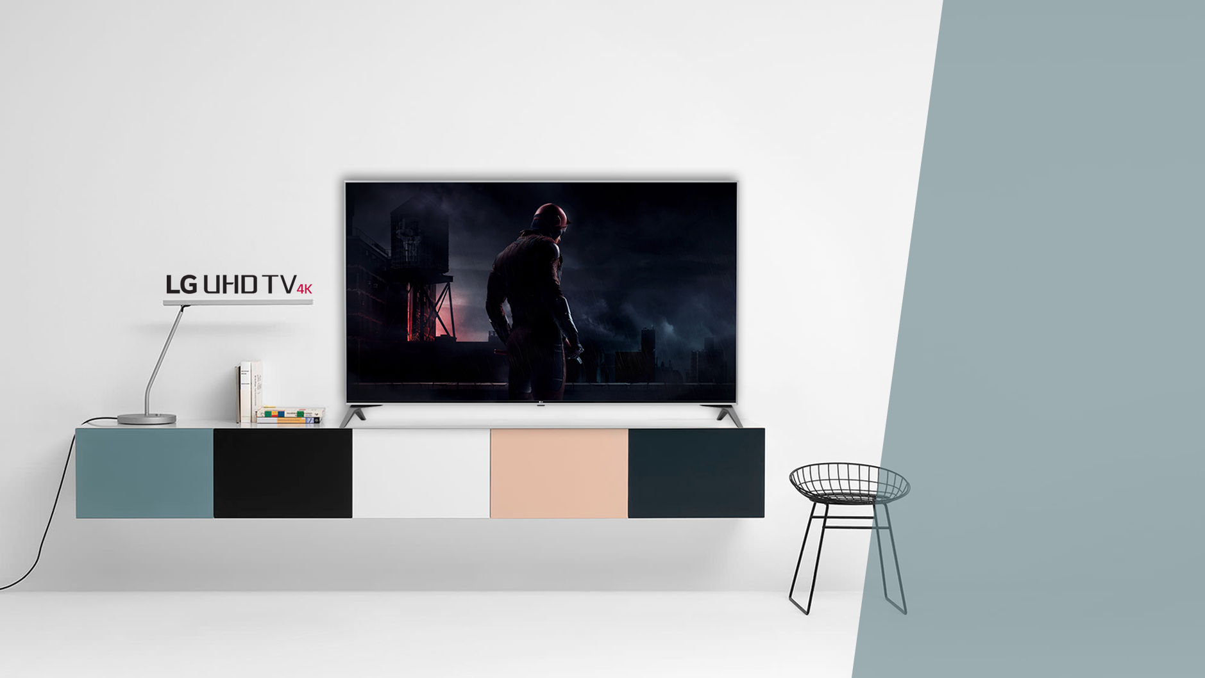
UJ75
^{Imagem}
^{Ultra HD 4K}
^{4K Upscaler}
^{HDR 10 / HDR Effect}
^{Wide Color GamuT DCI 90%}
AMPLO ÂNGULO DE VISÃO – NANO CELL
^{Local Dimming}
^{Ultra Luminância}
^{Dolby Vision}
^{frequência 120}
49UJ7500
^{SMART TV}
^{WEBOS 3.5}
^{Live Zoom}
^{Quick Access}
^{Magic Mobile Connection}
^{Time Machine READY}
^{Music Player}
^{Controle smart magic}
^{som}
^{HARMAN/KARDON}
^{Ultra Surround}
^{Modo Smart Sound}
^{Sound Sync wireless}
^{EXTRAS}
^{4 HDMI 2.0}
^{2 USB}
^{1 saída digital óptica}
^{1 Saída P2}
^{Quad Core}

Slide 14
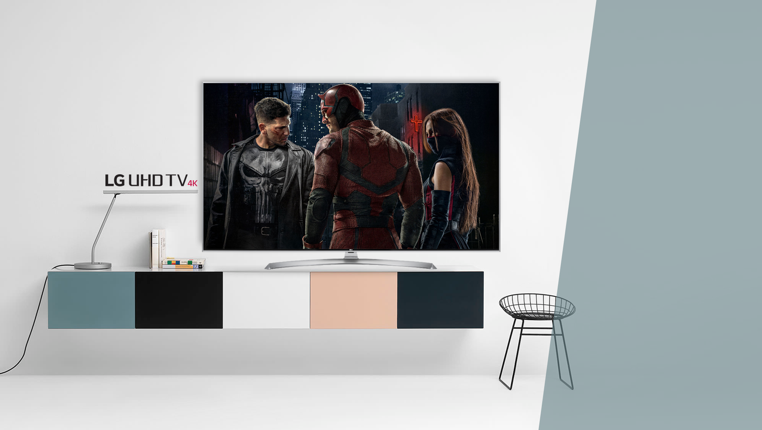
UJ75
55UJ7500
^{Imagem}
^{Ultra HD 4K}
^{4K Upscaler}
^{HDR 10 / HDR Effect}
^{Wide Color GamuT DCI 90%}
AMPLO ÂNGULO DE VISÃO – NANO CELL
^{Local Dimming}
^{Ultra Luminância}
^{Dolby Vision}
^{frequência 120}
^{SMART TV}
^{WEBOS 3.5}
^{Live Zoom}
^{Quick Access}
^{Magic Mobile Connection}
^{Time Machine READY}
^{Music Player}
^{Controle smart magic}
^{som}
^{HARMAN/KARDON}
^{Ultra Surround}
^{Modo Smart Sound}
^{Sound Sync wireless}
^{EXTRAS}
^{4 HDMI 2.0}
^{2 USB}
^{1 saída digital óptica}
^{1 Saída P2}
^{Quad Core}

Slide 15
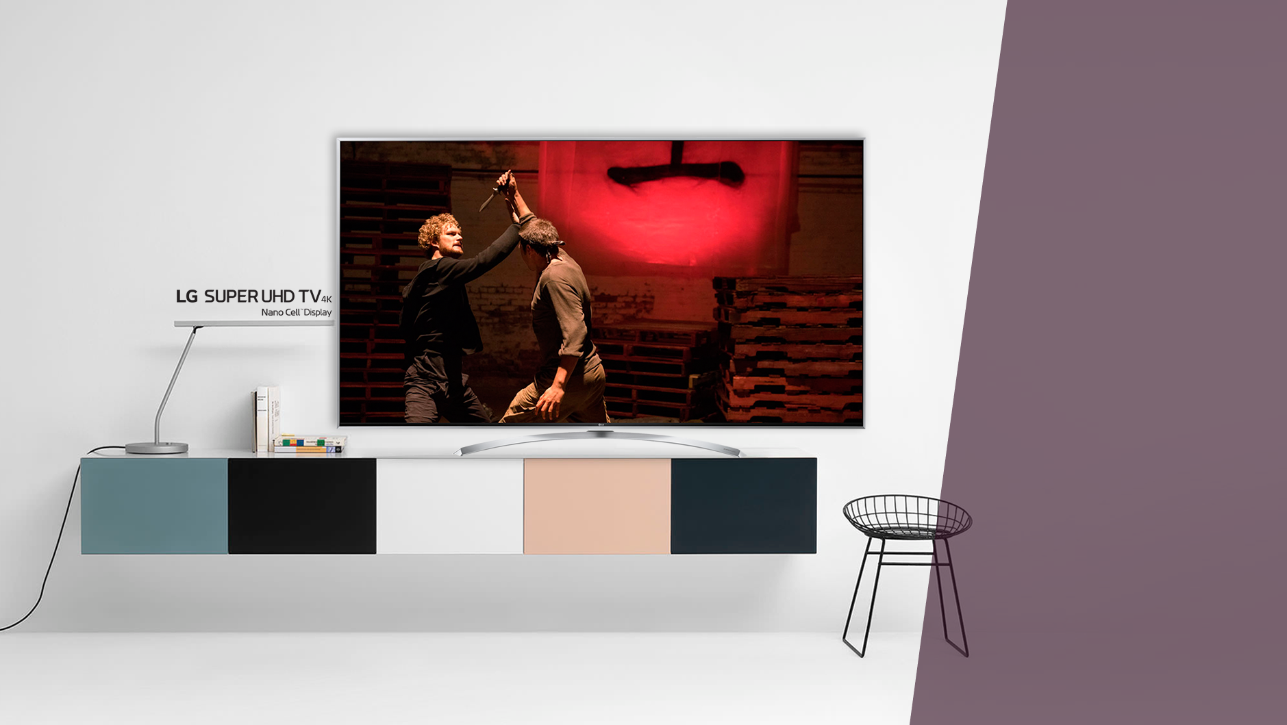
SJ80
49 / 55 / 65SJ8000
^{Imagem}
^{Ultra HD 4K}
^{4K Upscaler}
^{HDR 10 / HDR Effect}
^{Wide Color GamuT DCI 90%}
AMPLO ÂNGULO DE VISÃO – NANO CELL
^{Local Dimming}
^{Ultra Luminância}
^{Dolby Vision}
^{10 Bit color}
^{Frequência 240}
^{SMART TV}
^{WEBOS 3.5}
^{Live Zoom}
^{Quick Access}
^{Magic Mobile Connection}
^{Time Machine READY}
^{Music Player}
^{Controle smart magic}
^{som}
^{HARMAN/KARDON}
^{Ultra Surround}
^{Modo Smart Sound}
^{Sound Sync wireless}
^{20W RMS 2.0}
^{EXTRAS}
^{4 HDMI 2.0}
^{3 USB}
^{1 saída digital óptica}
^{1 Saída P2}
^{Quad Core}

Slide 16
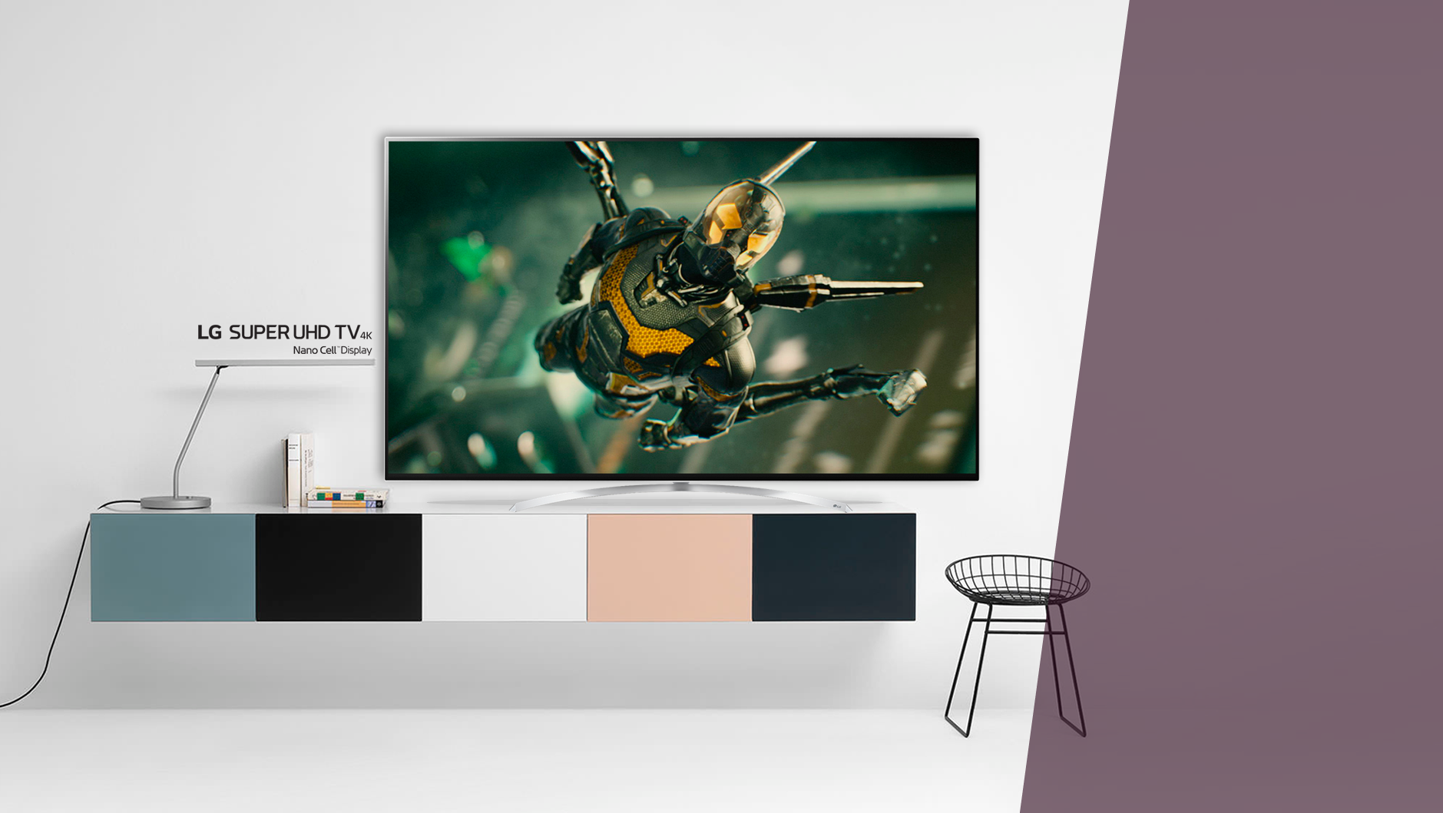
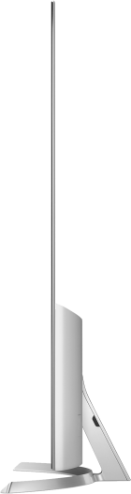
SJ95
55 / 65SJ9500
^{Imagem}
^{Ultra HD 4K}
^{4K Upscaler}
^{HDR 10 / HDR Effect}
^{Wide Color GamuT DCI 94%}
AMPLO ÂNGULO DE VISÃO – NANO CELL
^{Advanced Local Dimming}
^{Ultra Luminance Supreme}
^{Dolby Vision}
^{10 Bit color}
^{Frequência 240}
^{SMART TV}
^{WEBOS 3.5}
^{Live Zoom}
^{Quick Access}
^{Magic Mobile Connection}
^{Time Machine READY}
^{Music Player}
^{Controle smart magic}
^{som}
^{HARMAN/KARDON}
^{Ultra Surround}
^{Modo Smart Sound}
^{Sound Sync wireless}
^{40w rms 2.2}
^{EXTRAS}
^{4 HDMI 2.0}
^{3 USB}
^{1 saída digital óptica}
^{1 Saída P2}
^{Quad Core}

Slide 17
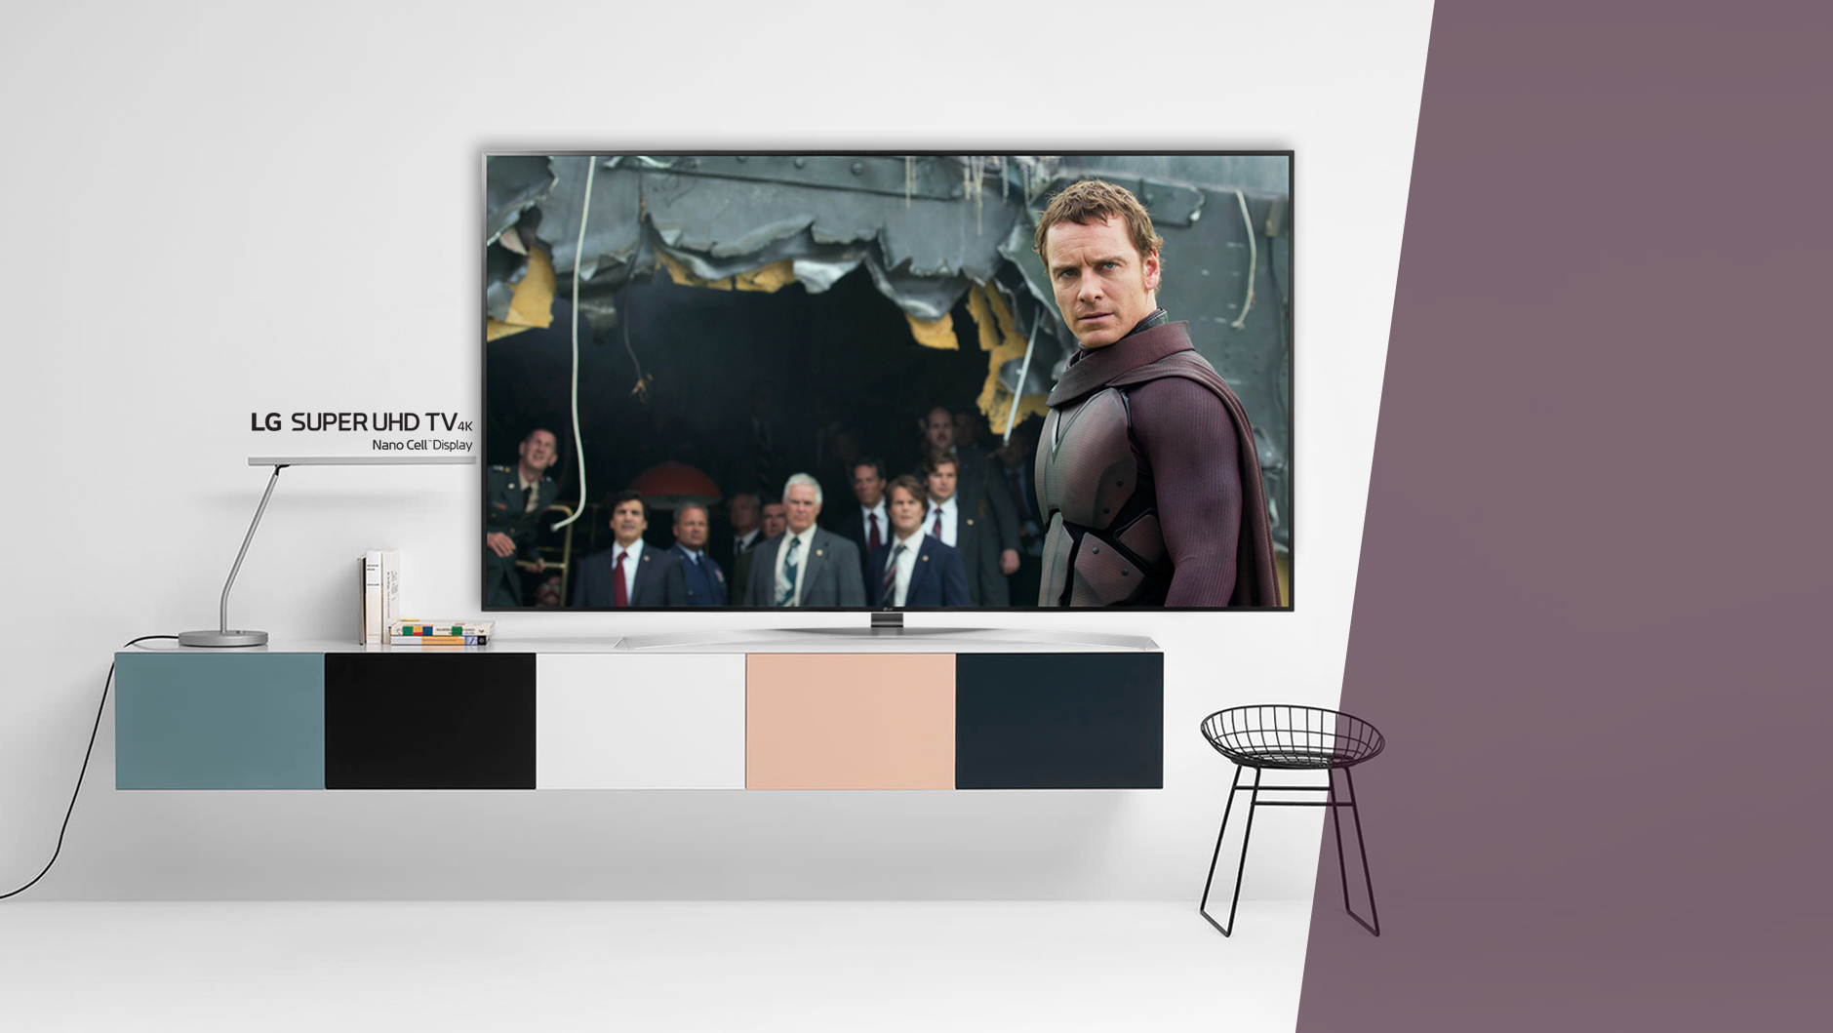
SJ95
86SJ9570
^{Imagem}
^{Ultra HD 4K}
^{4K Upscaler}
^{HDR 10 / HDR Effect}
^{Wide Color GamuT DCI 91%}
AMPLO ÂNGULO DE VISÃO – Painel IPS
^{Advanced Local Dimming}
^{Ultra Luminância}
^{Dolby Vision}
^{10 Bit color}
^{Frequência 240}
^{SMART TV}
^{WEBOS 3.5}
^{Live Zoom}
^{Quick Access}
^{Magic Mobile Connection}
^{Time Machine READY}
^{Music Player}
^{Controle smart magic}
^{som}
^{HARMAN/KARDON}
^{Ultra Surround}
^{Modo Smart Sound}
^{Sound Sync wireless}
^{80W Rms 5.2}
^{EXTRAS}
^{4 HDMI 2.0}
^{3 USB}
^{1 saída digital óptica}
^{1 Saída P2}
^{Quad Core}

Slide 18
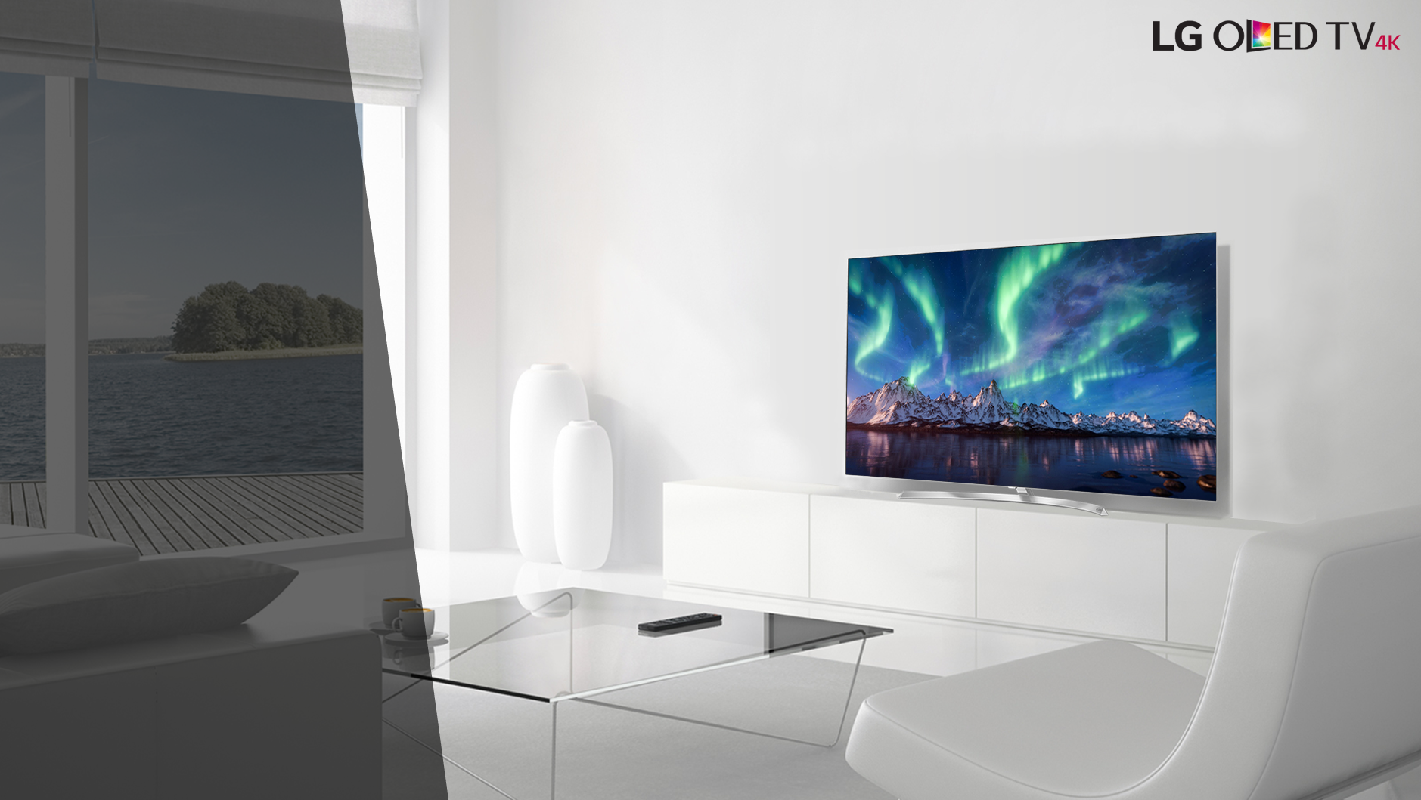
OLED55B7P
^{Imagem}
^{POLEGADAS 55”}
^{RESOLUÇÃO ULTRA HD 4K}
^{PRETO PURO}
^{CONTRASTE INFINITO}
^{ULTRA LUMINÂNCIA}
^{PELÍCULA ANTI REFLEXO}
^{Wide Color GamuT DCI 98,5%}
^{Dolby Vision}
^{Hdr10 / Hlg}
^{Efeito Hdr}
^{10-bit Color}
^{Frequência 120}
^{design}
^{Blade slim}
^{Base Crescent Stand}
^{Smart}
^{webOS 3.5}
^{Controle Smart Magic}
^{OLED Gallery}
^{Magic Mobile Connection}
^{Quick access}
^{magic zoom}
^{music player}
^{sound sync}
^{som}
^{Sistema de som Dolby Atmos®}
^{Potência: 40W RMS}
^{Sistema de Som: 2.2 Ch}

Slide 19
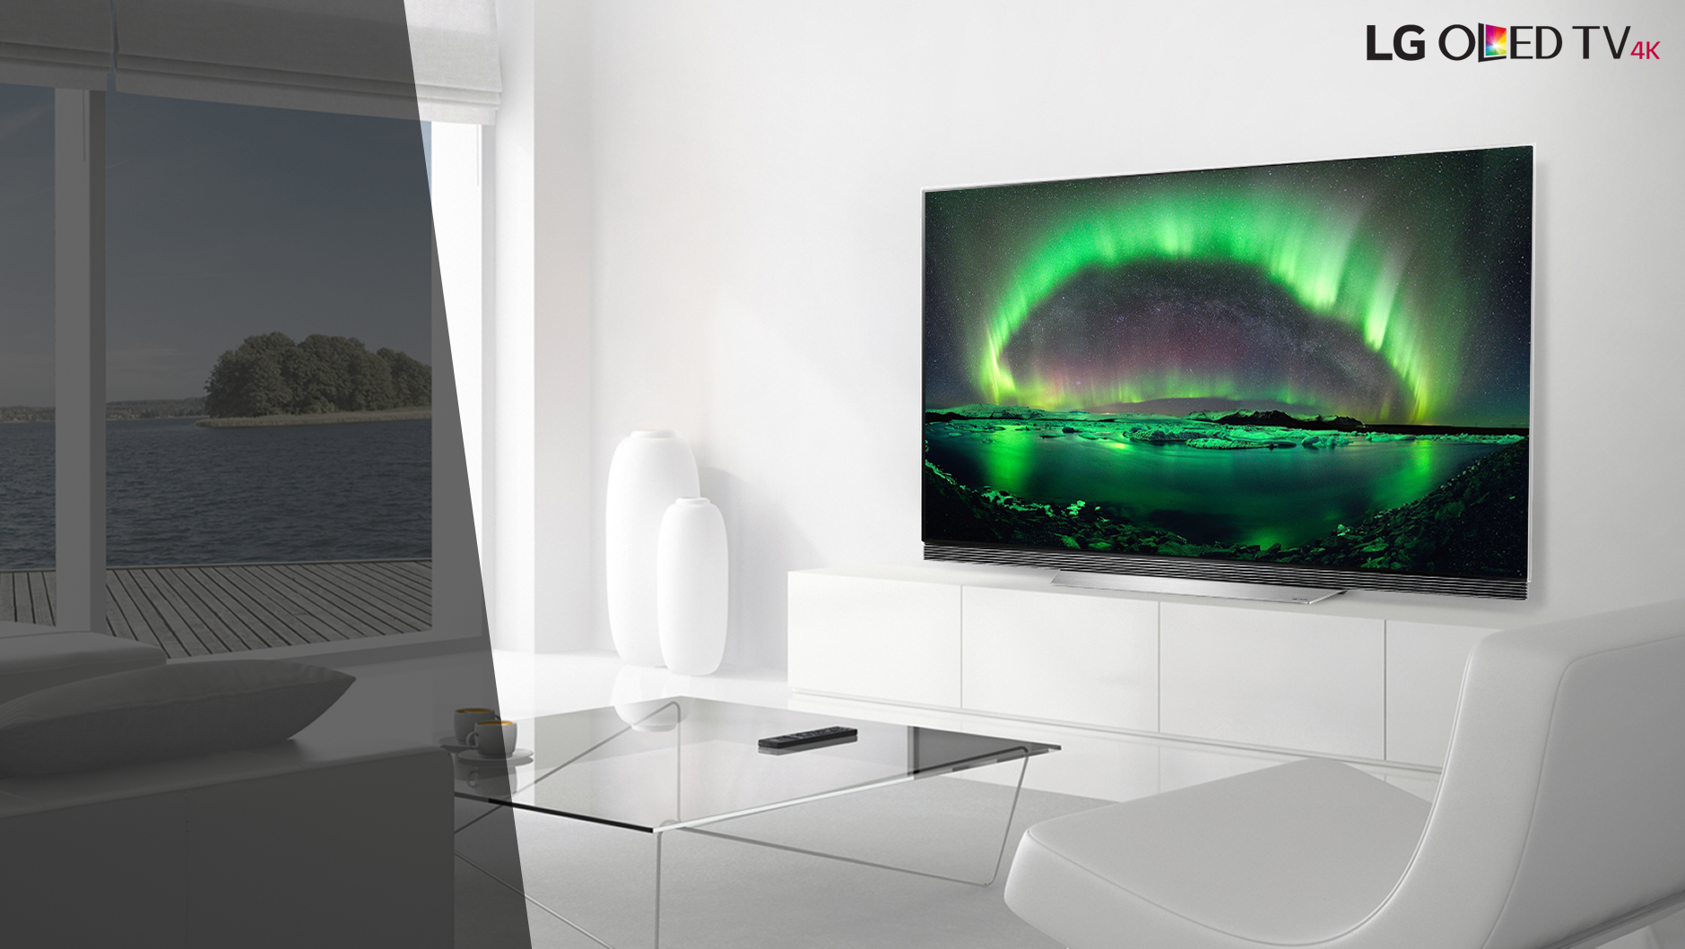
OLED65E7P
^{Imagem}
^{POLEGADAS 65”}
^{RESOLUÇÃO ULTRA HD 4K}
^{PRETO PURO}
^{CONTRASTE INFINITO}
^{ULTRA LUMINÂNCIA}
^{PELÍCULA ANTI REFLEXO}
^{Wide Color GamuT DCI 98,5%}
^{Dolby Vision}
^{Hdr10 / Hlg}
^{Efeito Hdr}
^{10-bit Color}
^{Frequência 120}
^{design}
^{Picture-on-glass}
^{Blade slim}
^{Smart}
^{webOS 3.5}
^{Controle Smart Magic}
^{OLED Gallery}
^{Magic Mobile Connection}
^{Quick access}
^{magic zoom}
^{music player}
^{sound sync}
^{som}
^{Base Sound Bar StanD}
^{Sistema de som Dolby Atmos®}
^{Potência: 60W RMS}
^{Sistema de Som: 4.2 Ch}

